Slide 1

Design Patterns
Design Patterns
Term Project
Team 3
20154490 김정빈
20155265 김재환
20152005 최범수
20153686 유인근
2019.12.09
Copyrightⓒ. Saebyeol Yu. All Rights Reserved.

Slide 2

CONTENTS
001
Jsoup 설계 및 구현 조사
설계 Overview
설계패턴 소개
002
Jsoup 기능 확장 및 설계 개선
확장 기능 내용
설계 개선 내용
003
Test 수행 내역
Junit Test
004
Team History
Progress History
Copyrightⓒ. Saebyeol Yu. All Rights Reserved.

Slide 3
Part 1.
Jsoup 설계 및 구현 조사
Jsoup 설계 및 구현 조사
Copyrightⓒ. Saebyeol Yu. All Rights Reserved.

Slide 4
Design Patterns
⑴ 설계 Overview
Jsoup Class Diagram

Slide 5
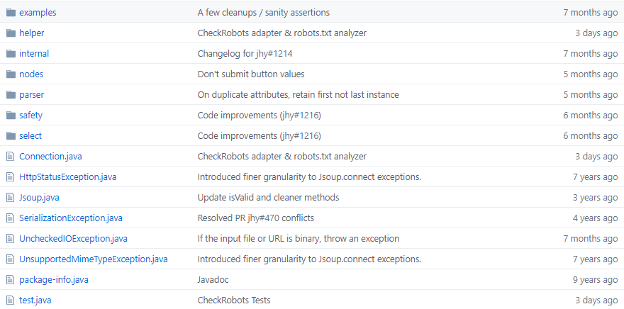
Design Patterns
⑴ 설계 Overview
Jsoup GitHub

Slide 6
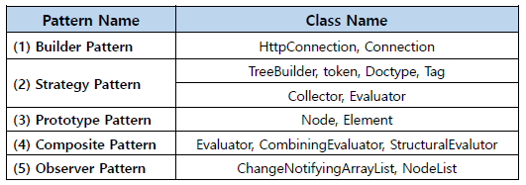
Design Patterns
⑴ 설계 Overview
Jsoup Design Patterns by Team3

Slide 7
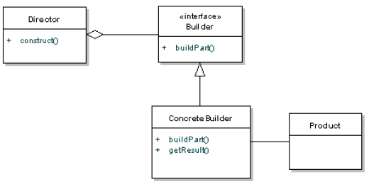
Design Patterns
⑵ Builder Pattern (1/6)
Builder Pattern

Slide 8
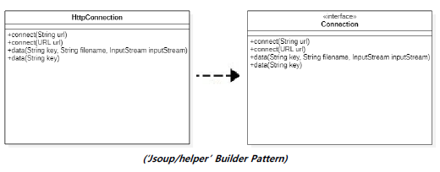
Design Patterns
⑵ Builder Pattern (1/6)

Slide 9
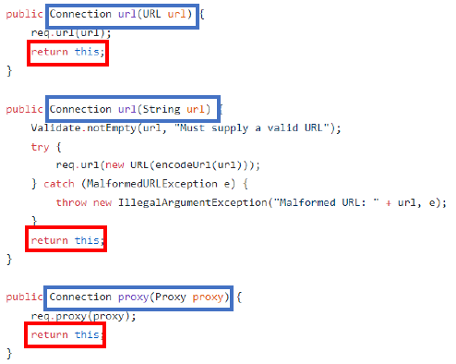
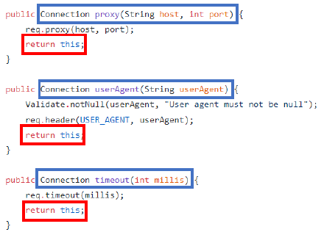
Design Patterns
⑵ Builder Pattern (1/6)
(‘Jsoup/helper’ Builder Pattern Source Code)

Slide 10
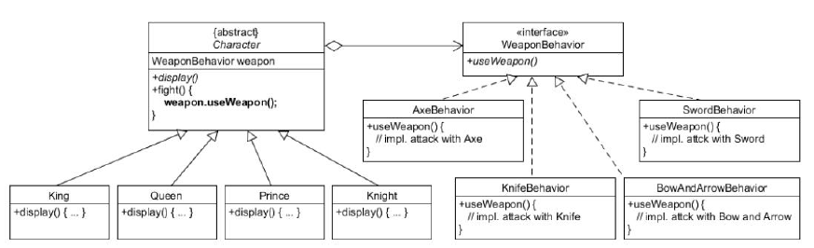
Design Patterns
⑵ Strategy Pattern (2/6)
Strategy Pattern

Slide 11
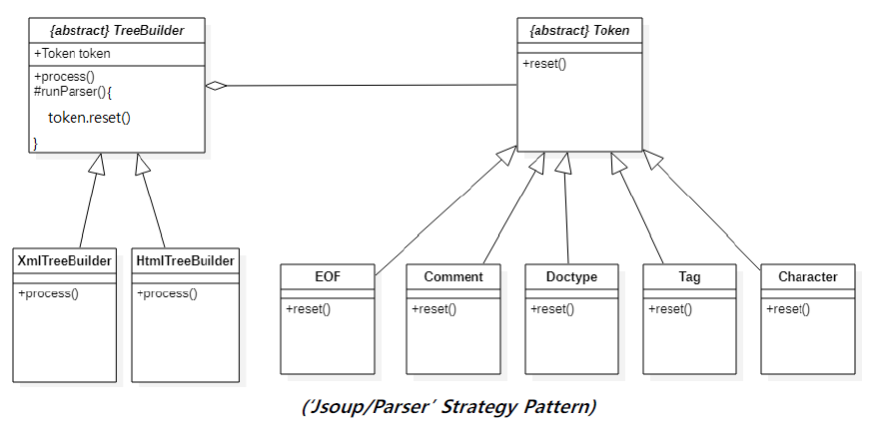
Design Patterns
⑵ Strategy Pattern (2/6)

Slide 12
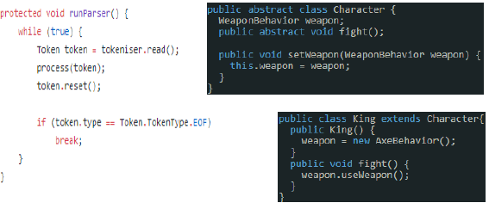
Design Patterns
⑵ Strategy Pattern (2/6)
(‘Jsoup/Parser’ Strategy Pattern Source Code)

Slide 13
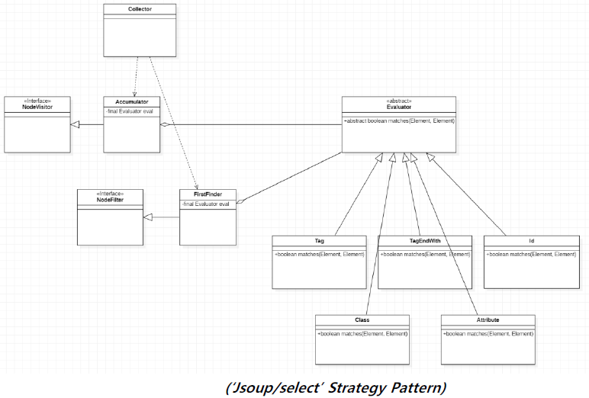
Design Patterns
⑵ Strategy Pattern (3/6)

Slide 14
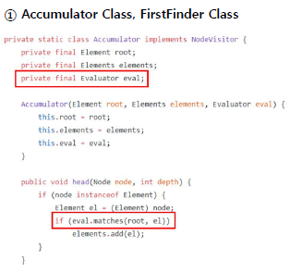
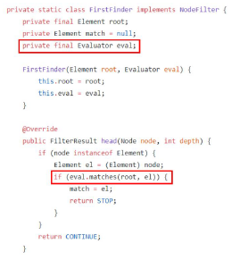
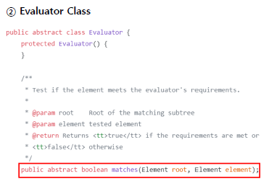
Design Patterns
⑵ Strategy Pattern (3/6)
(‘Jsoup/select’ Strategy Pattern Source Code)

Slide 15
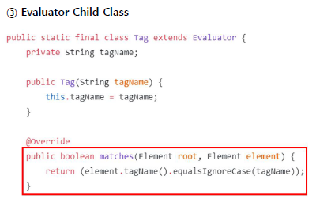
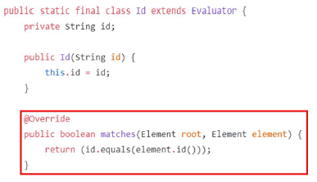
Design Patterns
⑵ Strategy Pattern (3/6)
(‘Jsoup/select’ Strategy Pattern Source Code)

Slide 16
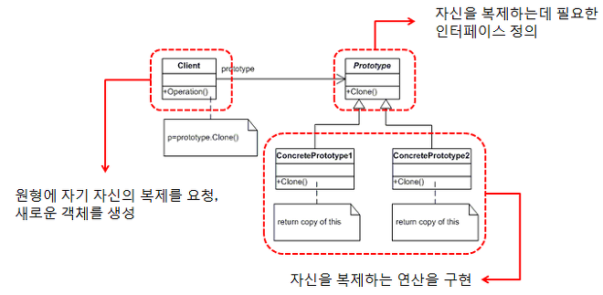
Design Patterns
⑵ Prototype Pattern (4/6)
Prototype Pattern

Slide 17
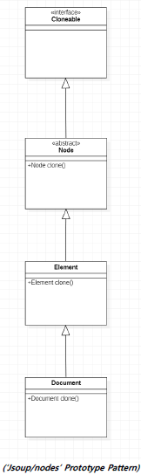
Design Patterns
⑵ Prototype Pattern (4/6)

Slide 18
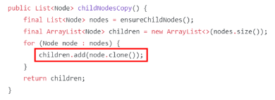
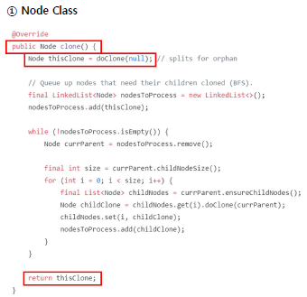
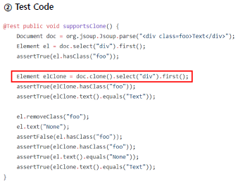
Design Patterns
⑵ Prototype Pattern (4/6)
(‘Jsoup/nodes’ Prototype Pattern Source Code)

Slide 19
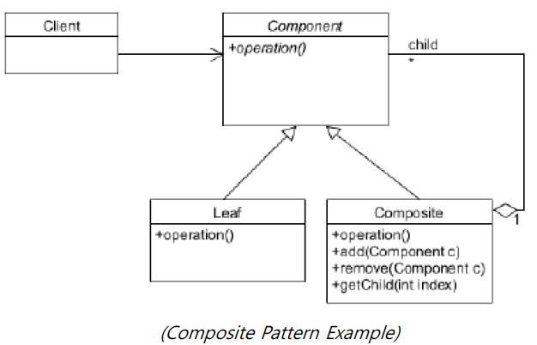
Design Patterns
⑵ Composite Pattern (5/6)

Slide 20
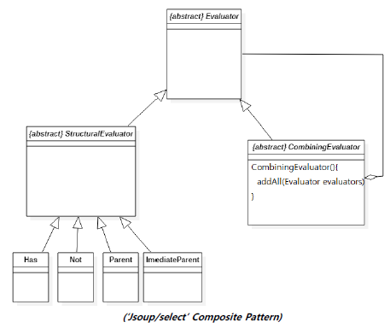
Design Patterns
⑵ Composite Pattern (5/6)

Slide 21
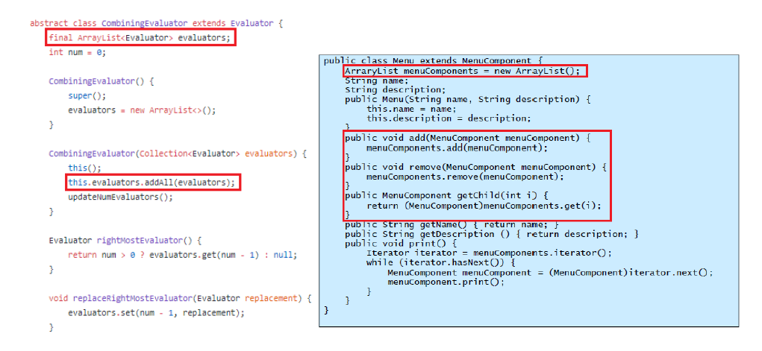
Design Patterns
⑵ Composite Pattern (5/6)
(‘Jsoup/select’ Composite Pattern Source Code)

Slide 22
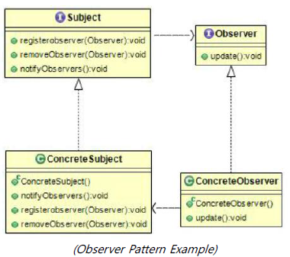
Design Patterns
⑵ Observer Pattern (6/6)

Slide 23
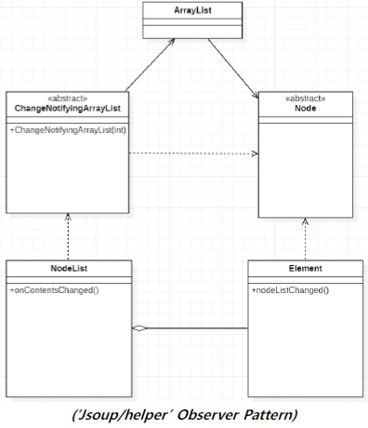
Design Patterns
⑵ Observer Pattern (6/6)

Slide 24
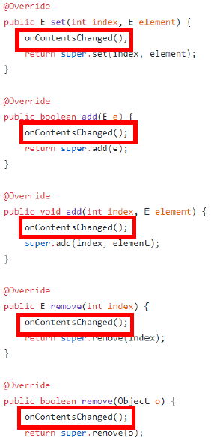
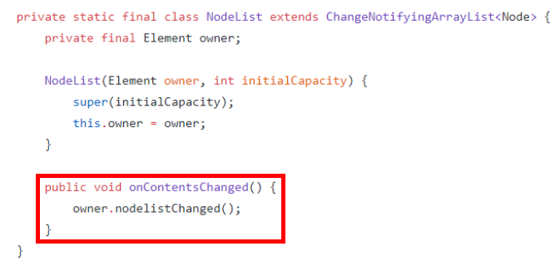
Design Patterns
⑵ Observer Pattern (6/6)

Slide 25
Part 2.
Jsoup 기능 확장 및 설계 개선
Jsoup 기능 확장 및 설계 개선
Copyrightⓒ. Saebyeol Yu. All Rights Reserved.

Slide 26
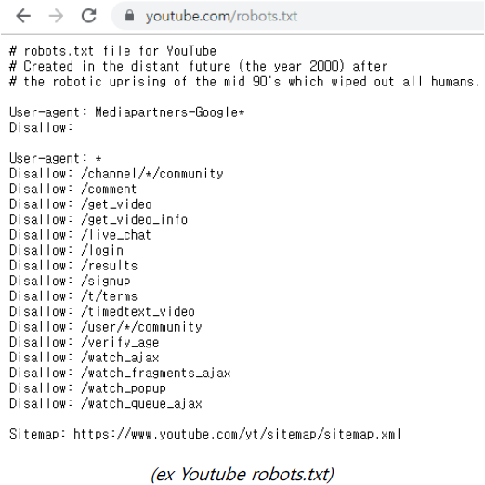
Design Patterns
⑴ 확장 기능 - robots.txt

Slide 27
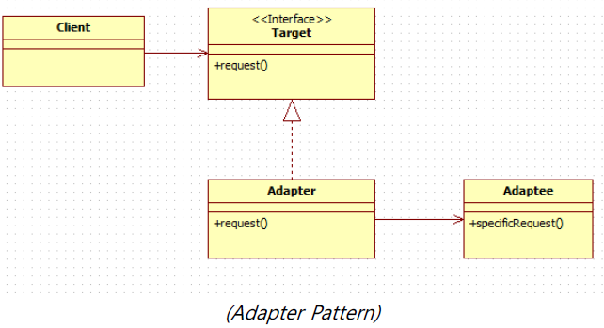
Design Patterns
⑴ 확장 기능 - robots.txt

Slide 28
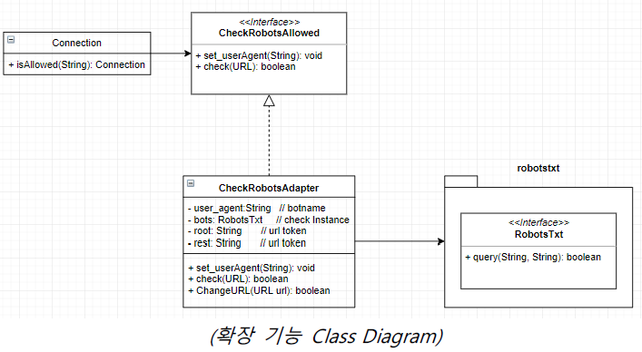
Design Patterns
⑴ 확장 기능 - robots.txt

Slide 29
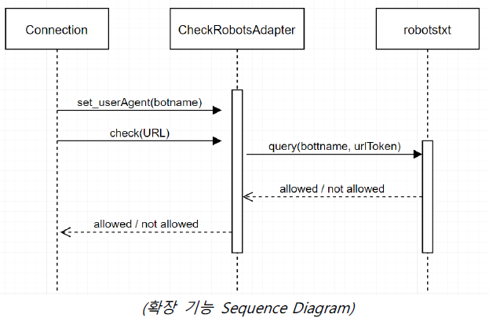
Design Patterns
⑴ 확장 기능 - robots.txt

Slide 30
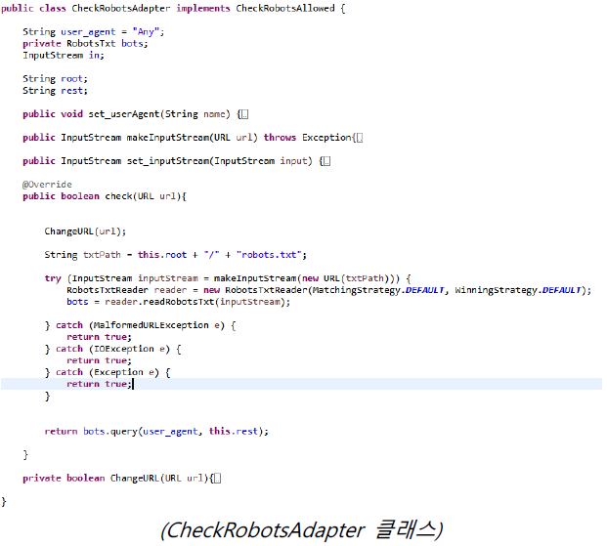
Design Patterns
⑴ 확장 기능 - robots.txt

Slide 31
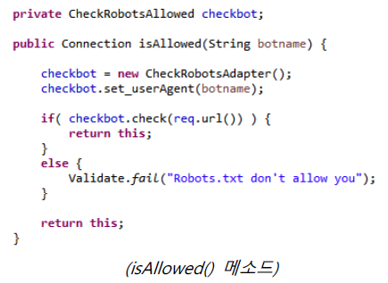
Design Patterns
⑴ 확장 기능 - robots.txt

Slide 32
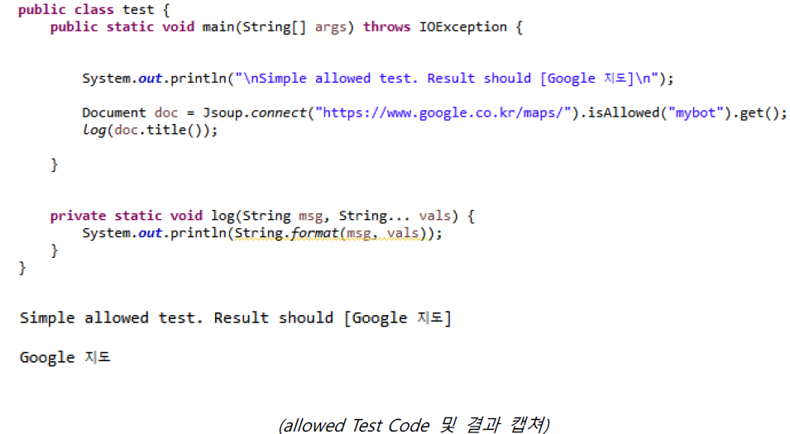
Design Patterns
⑴ 확장 기능 - robots.txt

Slide 33
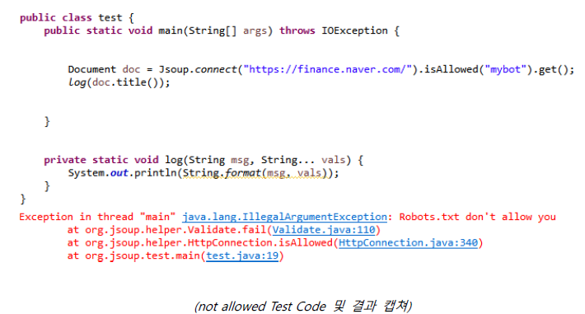
Design Patterns
⑴ 확장 기능 - robots.txt

Slide 34
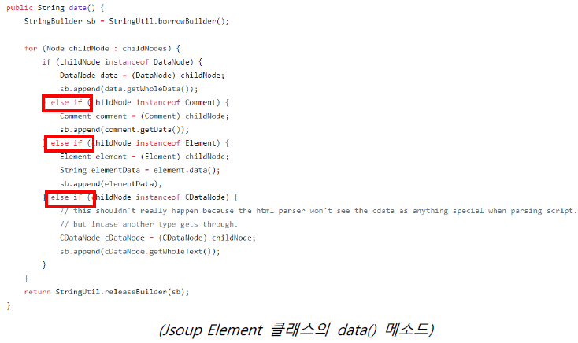
Design Patterns
⑵ 설계 개선

Slide 35
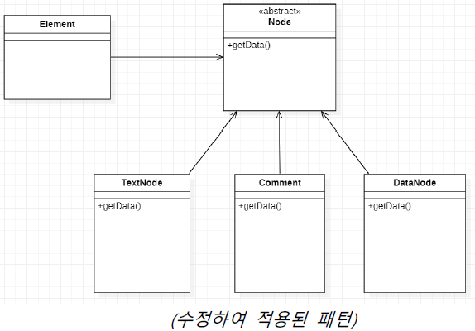
Design Patterns
⑵ 설계 개선

Slide 36
Part 3.
Test 수행 내역
Test 수행 내역
Copyrightⓒ. Saebyeol Yu. All Rights Reserved.

Slide 37
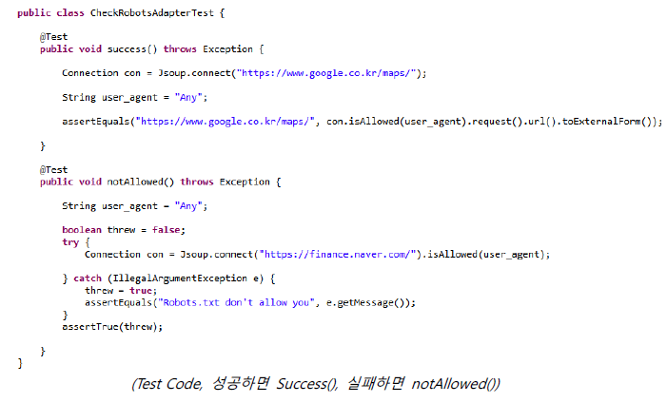
Design Patterns
⑴ Junit Test(확장 기능)

Slide 38
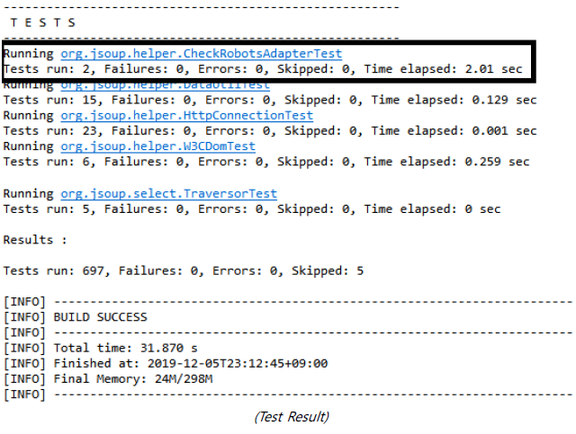
Design Patterns
⑴ Junit Test(확장 기능)

Slide 39
Part 4.
Team History
Team History
Copyrightⓒ. Saebyeol Yu. All Rights Reserved.

Slide 40
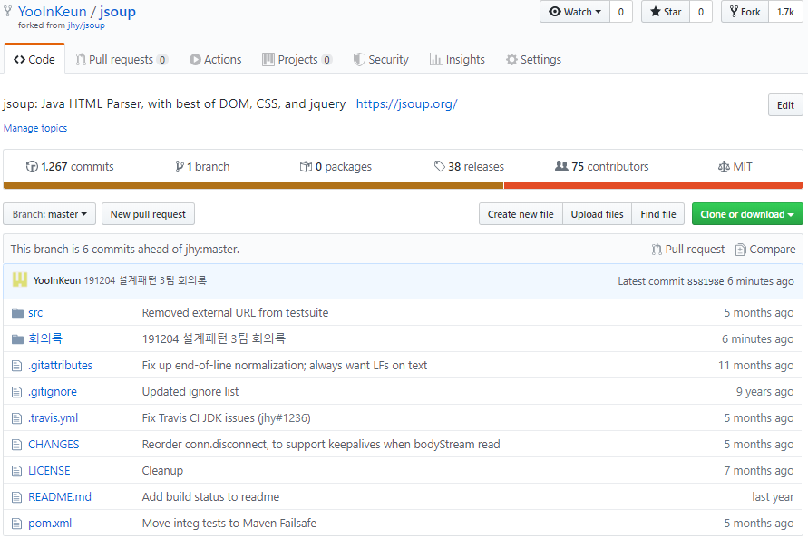
Design Patterns
⑴ Team History
GitHub Repository: https://github.com/YooInKeun/jsoup

Slide 41
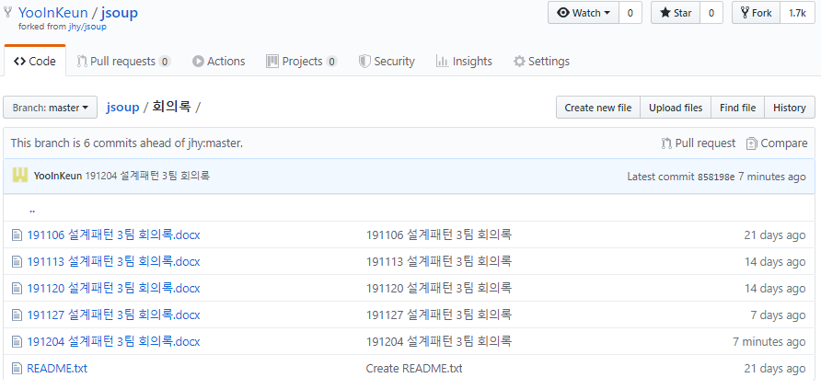
Design Patterns
⑴ Team History
GitHub Repository: https://github.com/YooInKeun/jsoup

Slide 42
Thank You!
Copyrightⓒ. Saebyeol Yu. All Rights Reserved.

